Slide 1
Databases
Deepen your knowledge in SQL
Notes:
1
20483C
1: Review of Visual C# Syntax

Slide 2
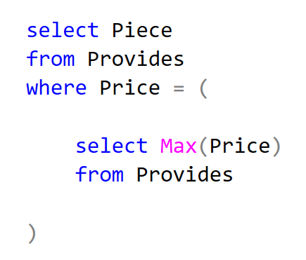
Subqueries
Notes:
A Subquery or Inner query or a Nested query is a query within another SQL query and embedded within the WHERE clause.
A subquery is used to return data that will be used in the main query as a condition to further restrict the data to be retrieved.
Subqueries can be used with the SELECT, INSERT, UPDATE, and DELETE statements along with the operators like =, <, >, >=, <=, IN, BETWEEN, etc.
2
20483C
1: Review of Visual C# Syntax

Slide 3
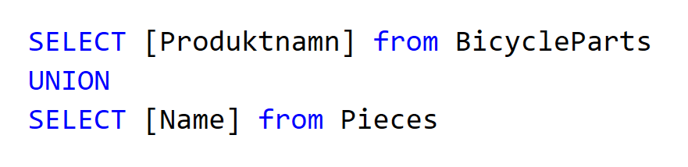
Sets
Notes:
- Set operators gives unique values (no duplicates)
- The datatypes must be comparable (e.g "text" is not comparable)
Other set operators:
- EXCEPT
- INTERSECT
3
20483C
1: Review of Visual C# Syntax

Slide 4
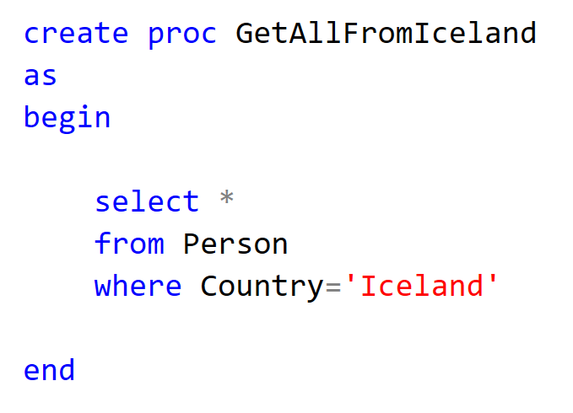

Stored Procedures
Notes:
A stored procedure is a prepared SQL code that you can save, so the code can be reused over and over again.
So if you have an SQL query that you write over and over again, save it as a stored procedure, and then just call it to execute it.
You can also pass parameters to a stored procedure, so that the stored procedure can act based on the parameter value(s) that is passed.
4
20483C
1: Review of Visual C# Syntax

Slide 5
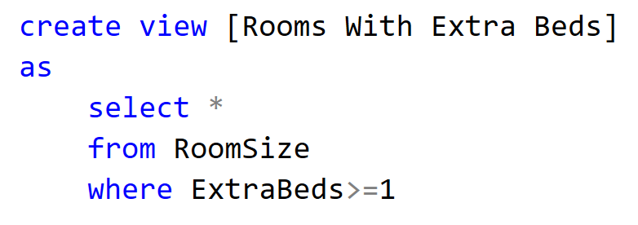
Views
Notes:
In SQL, a view is a virtual table based on the result-set of an SQL statement.
A view contains rows and columns, just like a real table. The fields in a view are fields from one or more real tables in the database.
You can add SQL functions, WHERE, and JOIN statements to a view and present the data as if the data were coming from one single table.
A view always shows up-to-date data! The database engine recreates the data, using the view's SQL statement, every time a user queries a view.
5
20483C
1: Review of Visual C# Syntax

Slide 6
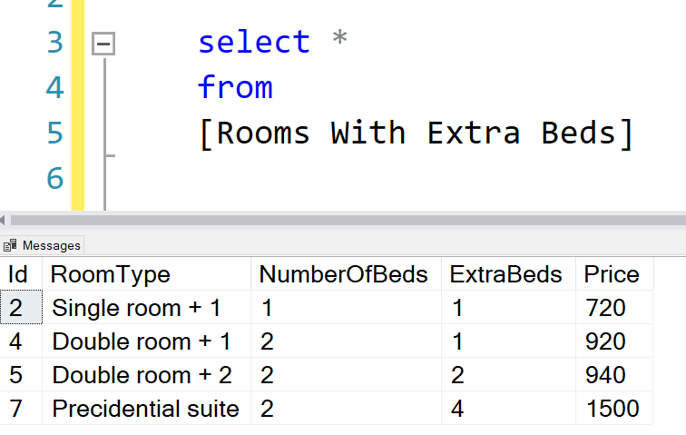
Views
Notes:
6
20483C
1: Review of Visual C# Syntax

Slide 7
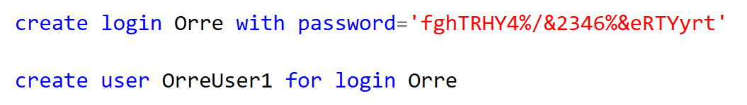

Users
Notes:
LOGIN is connected to the SERVER
USER is connected to a specific DATABASE
About db_datareader
- Members of the db_datareader fixed database role can read all data from all user tables.
- db_datareader is an example of a fixed-database role. These roles exist in all databases. The permissions of the roles can't change
You can create roles yourself as well and give a role a special permission
7
20483C
1: Review of Visual C# Syntax

Slide 8

Index
Notes:
Indexes are used to retrieve data from the database more quickly than otherwise.
Simply put, an index is a pointer to data in a table. An index in a database is very similar to an index in the back of a book.
For example, if you want to reference all pages in a book that discusses a certain topic, you first refer to the index, which lists all the topics alphabetically and are then referred to one or more specific page numbers.
An index helps to speed up SELECT queries and WHERE clauses, but it slows down data input, with the UPDATE and the INSERT statements. Indexes can be created or dropped with no effect on the data.
Indexes can also be unique, like the UNIQUE constraint, in that the index prevents duplicate entries in the column or combination of columns on which there is an index.
8
20483C
1: Review of Visual C# Syntax

Slide 9
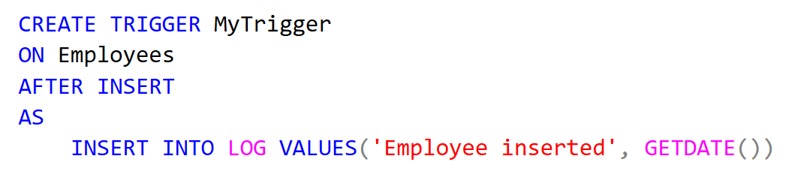
Trigger
Notes:
Purpose: show the use of "triggers" to do some action when something else occurs
A trigger is a stored procedure in database which automatically invokes whenever a special event in the database occurs. For example, a trigger can be invoked when a row is inserted into a specified table or when certain table columns are being updated.
Can trigger before or after something has happended. When someone login.
The trigger can insert, update, delete data
9
20483C
1: Review of Visual C# Syntax

Slide 10
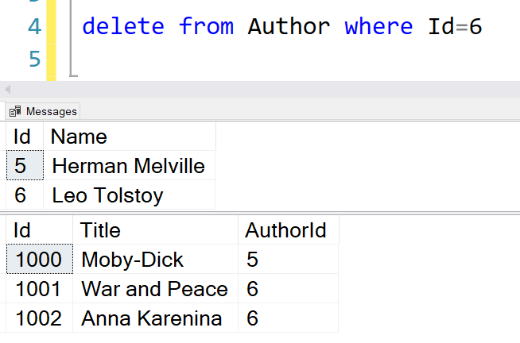
Cascade
Notes:
Purpose: shows different ways to handle the removing of a row in a "parent"-table
Delete cascade or update cascade in related to a foreign key
Different types of response:
- Give error message
- Set "null" to child rows
- Delete the child rows
10
20483C
1: Review of Visual C# Syntax

